Slide 1
Data Analysis
Supply Chain
Reporter: Mohamed Tarek - Amira El Hussein - Noha Afify
Aml Mohamed - Ahmed Ramzy
2024/10/22

Slide 2

Group B
Eng / Aml Mohamed
Mohamed Tarek
Amira El Hussein
Aml Mohamed
Ahmed Ramzy
Noha Afify

Slide 3
Tasks
Supply Chain Analysis
01
02
Presentation
03
Documentation

Slide 4
CONTENTS
01
02
03
Data Preparation
Analysis
Quesions
Dashboard

Slide 5
01
Data Preparation
Data Loading , Explanation and Cleaning

Slide 6
Road Map
Feature Explanation
Load Data
Data Cleaning
24 Fields
100 Rows & 24 Columns
Outliers
Data Preparation
SQL
Missing Value , Nulls & Duplication and add new fields
as a second tool

Slide 7
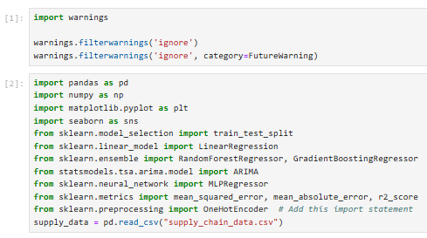
Import Libraries
Import warning library to ignore any warnings and focusing on errors only
Import essential libraries for data processing , cleaning , visualization and forecasting

Slide 8
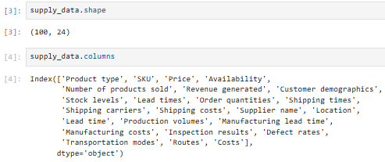
Data Exploration
100 Rows & 24 Columns
24 fields contain information about Product , customer , manfucture and Supplier

Slide 9
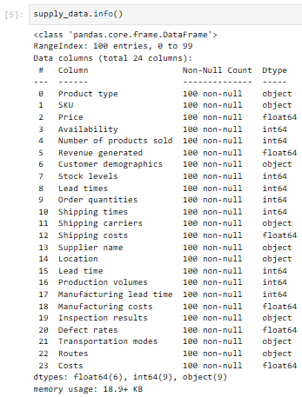
Data Exploration
6 Floating data
9 Integer data
9 String data
No Nulls

Slide 10
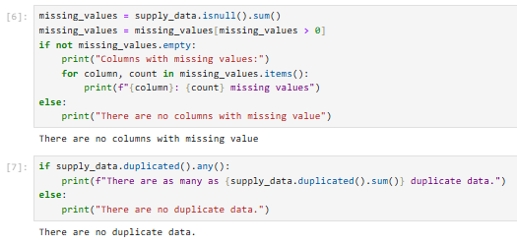
Data Preparation
No Missing Values
No Duplications

Slide 11
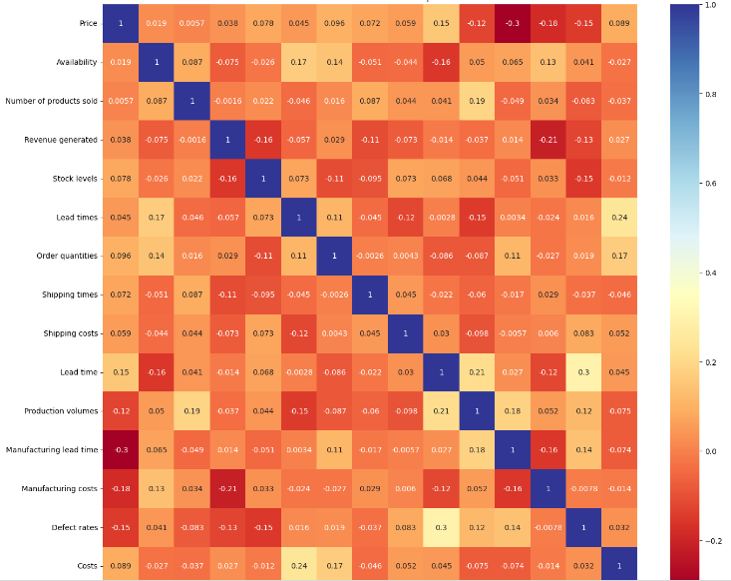
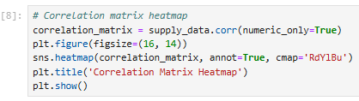
Data Preparation
Correlation is very weak between all fields

Slide 12


Data Preparation
Add new 4 columns to calculate the discount and over price percentage
100 Rows and 28 Columns

Slide 13
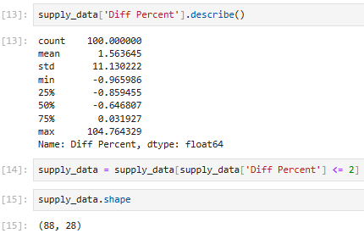
Data Cleaning
Assume that the data that have 200% overprice is wrong data entry because it is non logic
12 Rows deleted as outlier
88 Rows and 28 Columns

Slide 14
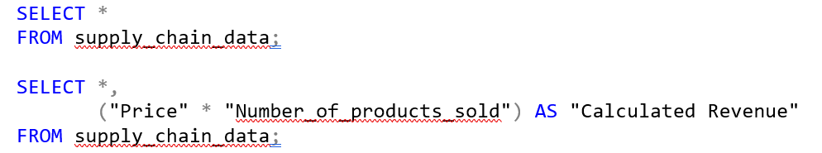
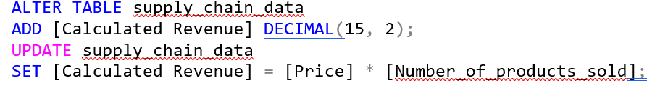
SQL
We Added a new column to calculate (Calculated Revenue) according to standard formula
Update the table to add this new column permanently

Slide 15
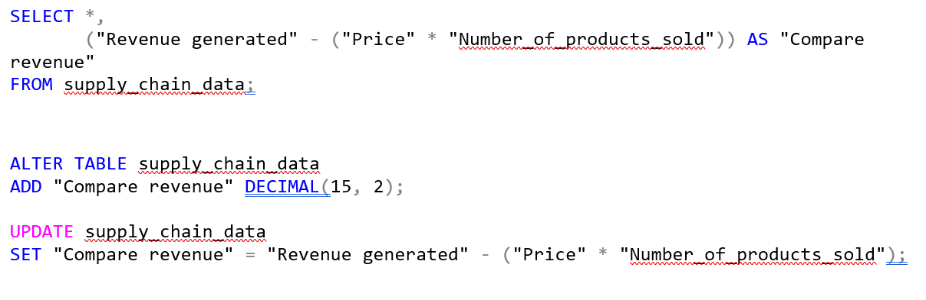
SQL
Compare between Revenue generated and Calculated Revenue to show the difference between these two columns
Added a new column (Compare revenue) to calculate the difference in revenue

Slide 16
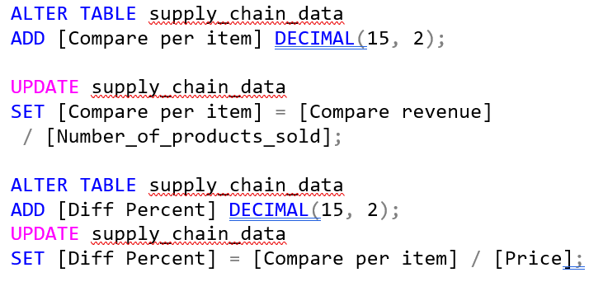
SQL
Show this difference as an item level
Added a new column (Compare per item)

Slide 17
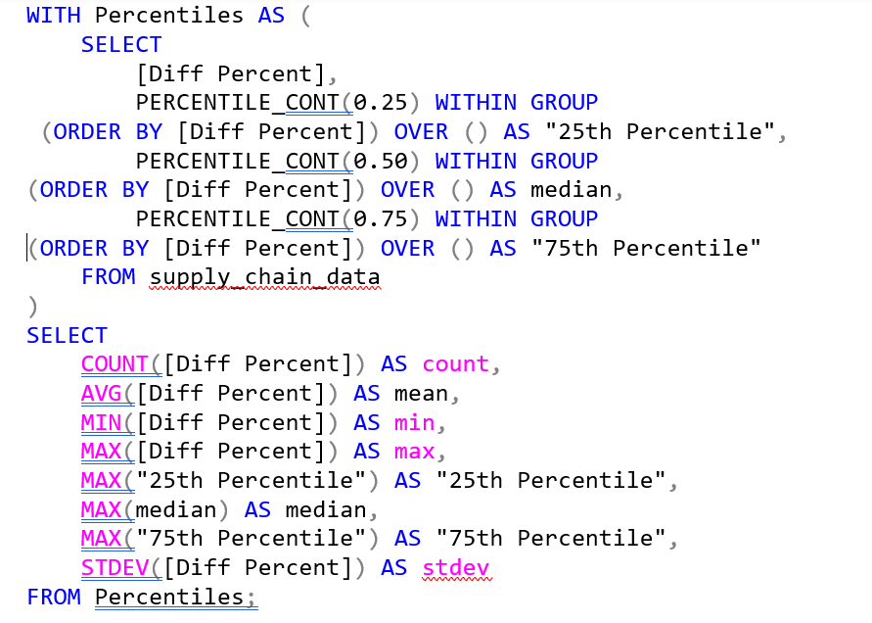
SQL

Slide 18
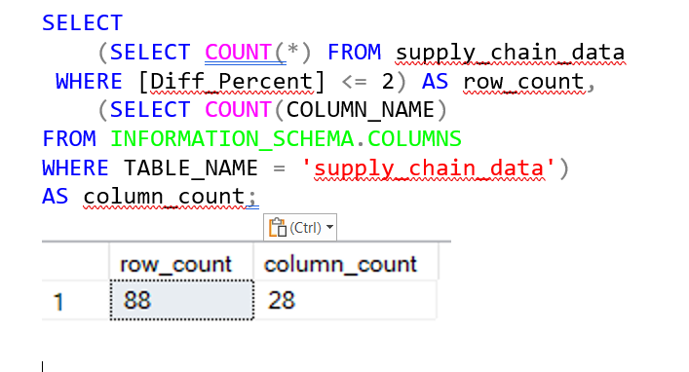
SQL

Slide 19

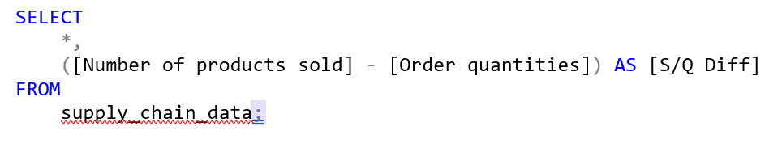
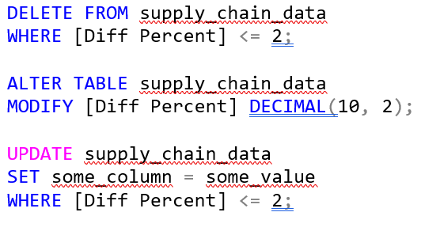

SQL
Eng / Ahmed Ramzy
Cleared any
illogical values

Slide 20
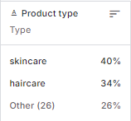
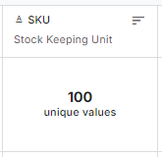
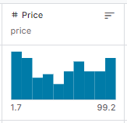
Data Explanation
3 Product Category
Primary Key
The price of item
Skincare , Haircare , Cosmetics
Unique for each product
( 100 unique No. from SKU0 to SKU99)
from 1.7 to 99.2

Slide 21
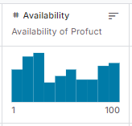
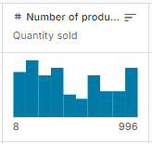
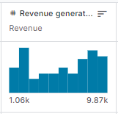
Data Explanation
Percent of items Available
from 8 to 996
Total revenue generated from product sales
from 1 to 100
from 1.06K to 9.87K

Slide 22
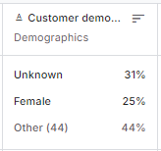
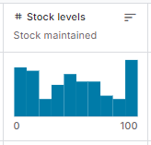
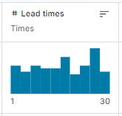
Data Explanation
Information about customer gender
Percent of products still available in stock
The time required to order or receive products from suppliers
Male – Female – Unknown - Nonbinary
from 0 to 100
from 1 to 30

Slide 23
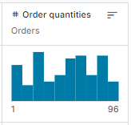
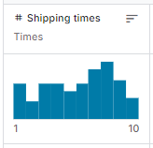
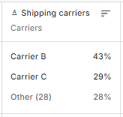
Data Explanation
The number of products ordered in one order
The time required to ship products from the warehouse
Carrier A – B – C
from 1 to 96
from 1 to 10

Slide 24
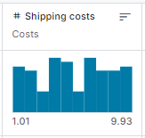
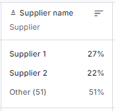
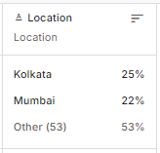
Data Explanation
from 1.01 to 9.93
Supplier 1 – 2 – 3 – 4 – 5
location of a warehouse or distribution center
Kolkata – Mumbai – Chennai – Bangalore – Delhi

Slide 25
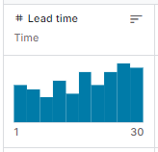
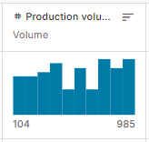
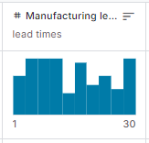
Data Explanation
The time required to obtain products or materials from a particular supplier
The number of products produced
The time required to produce a product
from 104 to 985
from 1 to 30
from 1 to 30

Slide 26
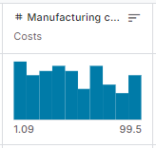
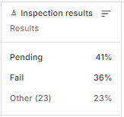
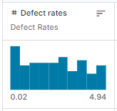
Data Explanation
from 1.09 to 99.5
Results of product or material quality inspection
The level of defects or defects in the products produced
Pending – Fail – Pass
from 0.02 to 4.94

Slide 27
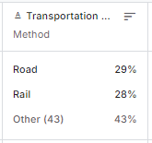
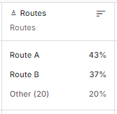
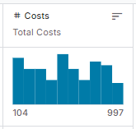

Data Explanation
The transportation methods
paths used to send products from one point to another
Costs including production costs and other costs
Road – Rail – Air – Sea
Route A – B - C
from 104 to 997
Eng / Noha Afify

Slide 28
02
Analysis Questions
what are the key fields ?

Slide 29
Road Map
Quality Control and Inspection
General Questions
Customer Insights
Inspection results
Product , Price ,Availability ,Shipping
Demographic , Patterns
Revenue-Related Questions
Supplier and Production
Presentations are communication tools.

Slide 30

General Questions
Product
What is the total revenue generated by each product type ?
How does product type influence the number of products sold ?
What is the average price of products across different product types ?

Slide 31
General Questions
Price
What is the relationship between pricing strategies and sales volume ?
How do discounts affect the revenue generated per product type ?

Slide 32
General Questions
Availability
&
stock levels
What is the correlation between product availability and sales performance ?
How do stock levels affect the order quantities for each product ?

Slide 33
General Questions
Lead Times
How do lead times impact the order quantities placed for different products ?
What is the average lead time across various suppliers, and how does it affect order fulfillment ?

Slide 34
General Questions
Shipping
What are the average shipping times for each transportation mode used ?
How do shipping costs vary by product type and shipping carrier ?

Slide 35
General Questions
Revenue
What factors contribute most significantly to overall revenue growth ?
How does the customer demographic impact the revenue generated ?
What is the relationship between the number of products sold and revenue ?

Slide 36
General Questions
Profitability
Which product types yield the highest profit margins ?
How do manufacturing and inspection costs impact overall profitability ?

Slide 37
Customer Insights
Demographics
What are the key demographics of our customer base, and how do they influence purchasing behavior ?
Are there specific customer segments that prefer certain product types or brands ?
What are the most common order quantities placed by customers ?

Slide 38
Supplier and Production Analysis
Supplier
Which suppliers consistently meet lead times, and how does this impact overall sales ?
What is the defect rate per supplier, and how does this influence product availability ?
How do changes in manufacturing lead times affect product availability and sales ?

Slide 39

Quality Control
Inspection
What are the common defects found during inspections, and how do they impact sales ?
Eng / Mohamed Tarek

Slide 40
03
Dashboard
Visualization and foreCasting using Tableau

Slide 41
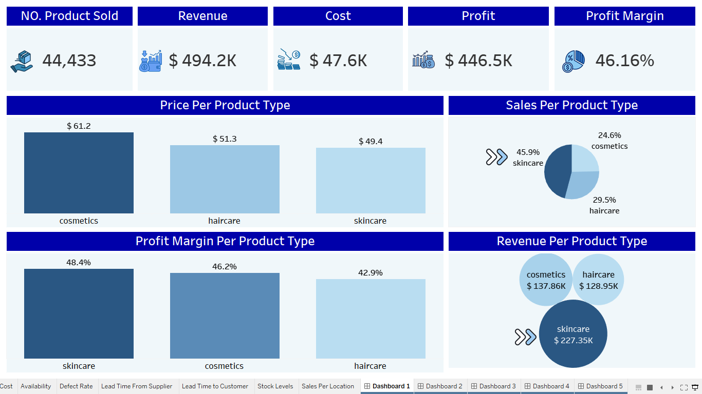

Slide 42
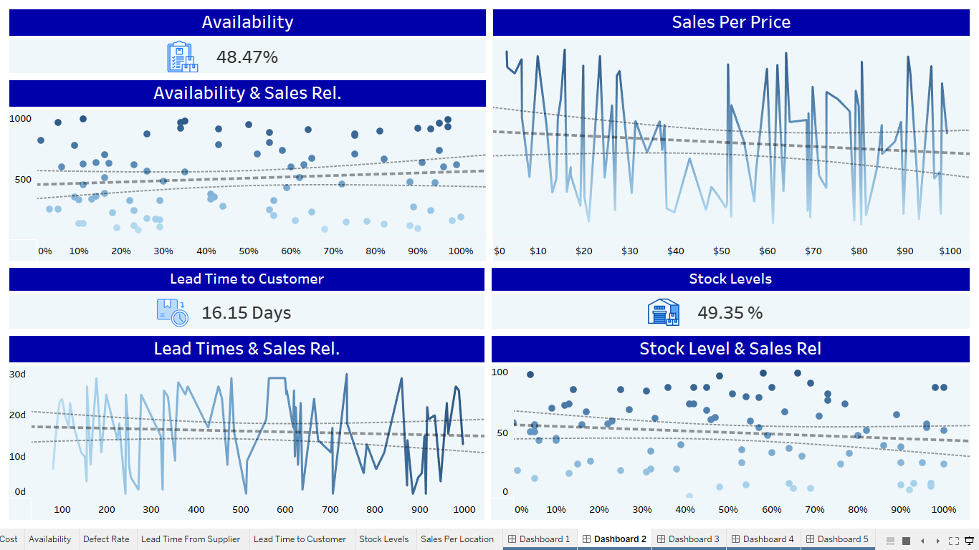

Slide 46
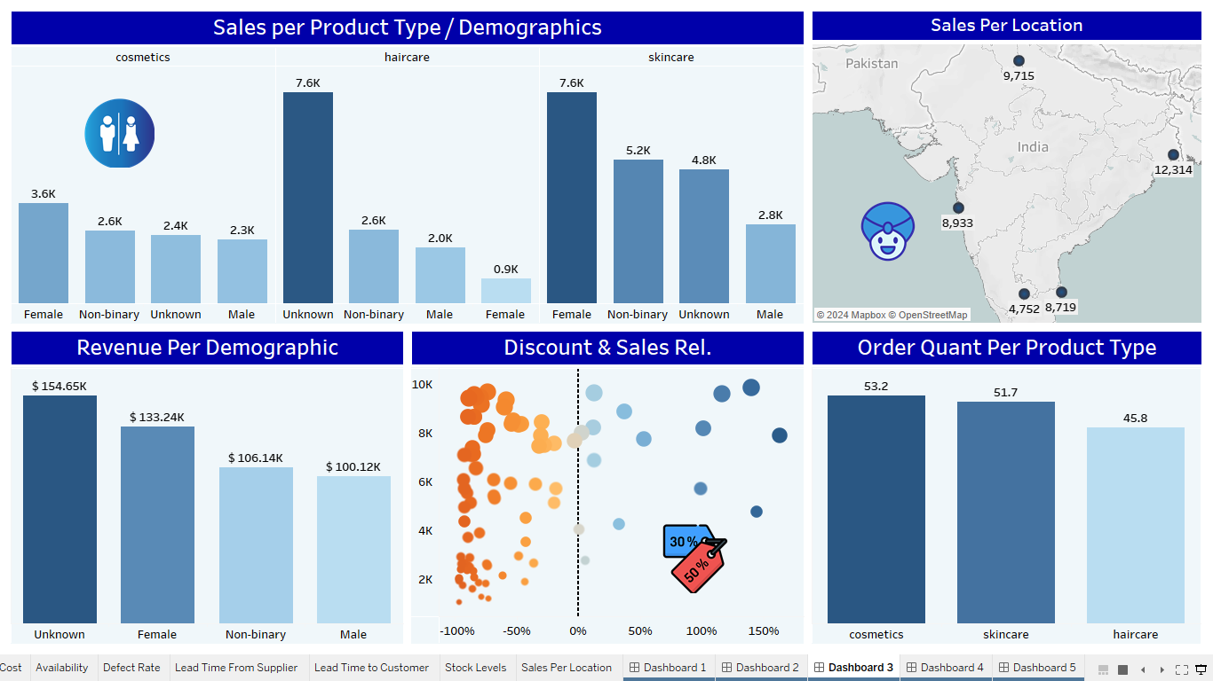

Slide 51
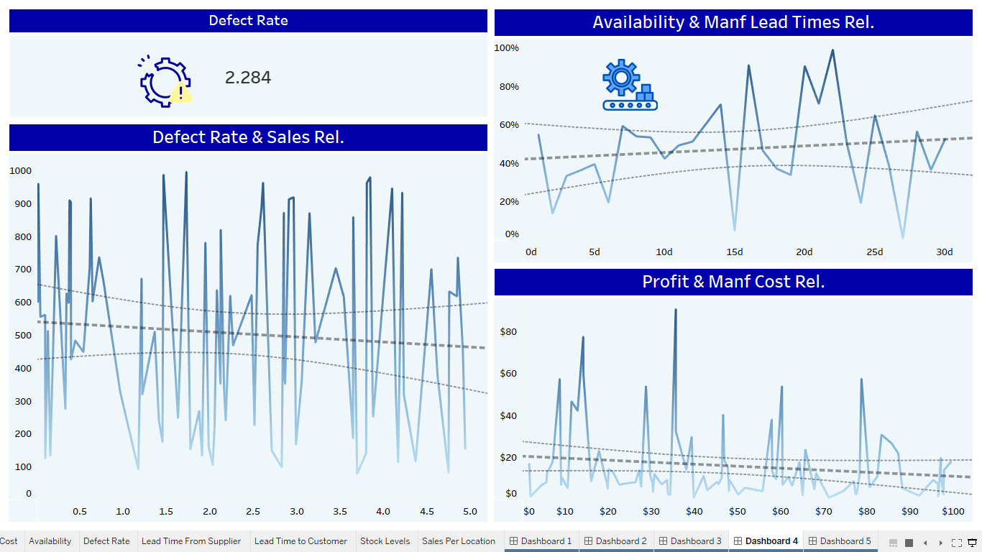

Slide 52

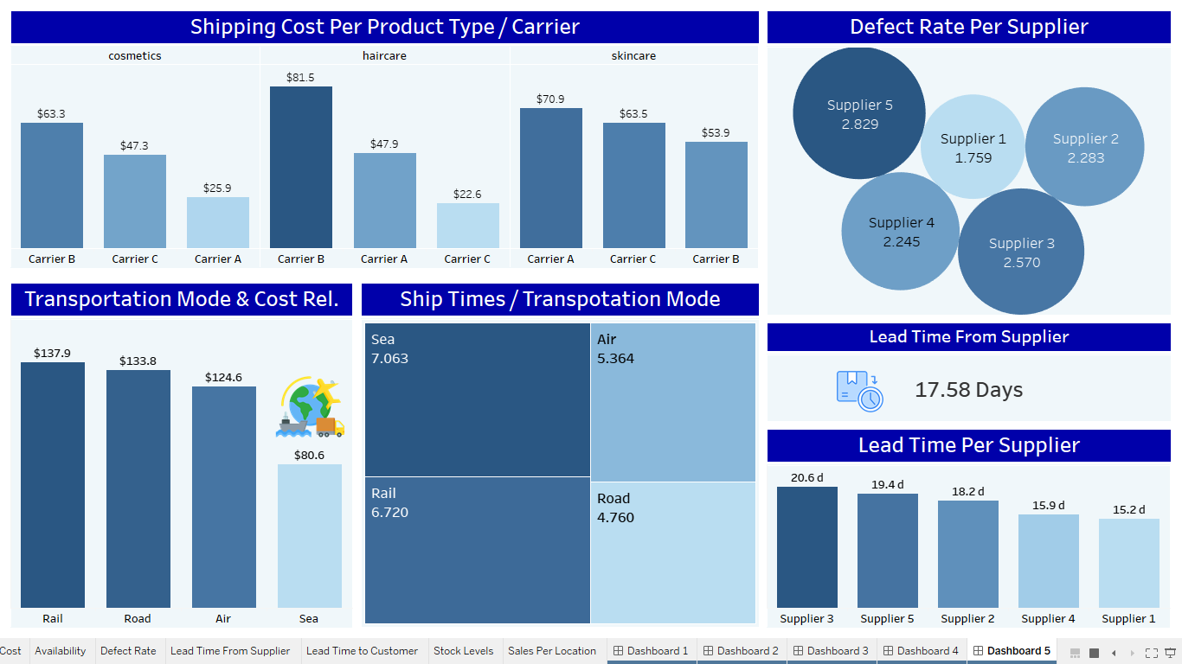
Eng / Amira Elussein

Slide 53
Recommendations
Focus on Skincare Product
Reorganization Availability as previously proposed
Focus on budget Product
Reorganization Stock Level as previously proposed
Focus on Female Customer
establish new warehouse at center of India

Slide 54

Gratitude
We want to express our deep gratitude to Engineer Ahmed Samir for his exceptional guidance and mentorship throughout the 5 months data analysis course. Your expertise, patience, and dedication as an instructor have been truly inspiring. Thank you for making complex concepts easier to understand and for always encouraging us to push our limits. This journey in data analysis would not have been the same without your support. we are incredibly thankful for all that we’ve learned from you!
Group B

Slide 55

Gratitude
Thank You, iLearn Academy
As I conclude this incredible learning journey, I want to express my deepest gratitude to iLearn Academy for providing such a transformative educational experience.
Group B

Slide 56

Gratitude
Thank You, Ministry of Communication and Information Technology
Exceptional Learning Experience
The knowledge and skills I’ve gained have been invaluable, and I now feel more empowered to take on new challenges.
Supportive Community
I am grateful for the guidance, encouragement, and resources from the amazing instructors and staff.
Looking Ahead
This course has laid a strong foundation for my future, and I look forward to applying everything I’ve learned!
Group B

Slide 57
THANKS

